Slide 1
Heap Sort

Slide 2

Heapsort
Complete binary tree
  all internal nodes have two children
  all leaves have depth d
Essentially complete binary tree
  it is a complete binary tree down to a depth of d-1
  The node with depth d are as far to the left as possible
Heap property: The value stored at each node is greater than or equal to the values stored at its children
Heap: an essentially complete binary tree satisfying heap property

Slide 3
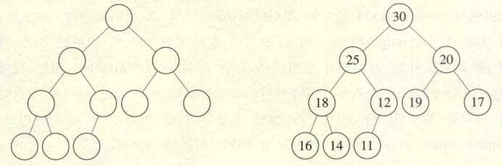
Essentially complete binary tree

Slide 4
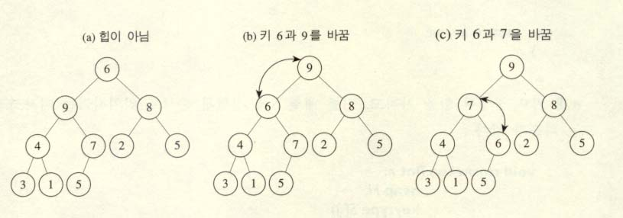
siftdown

Slide 5
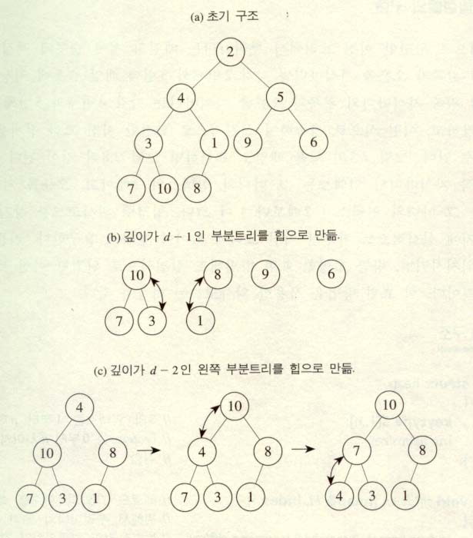
makeheap

Slide 6
Heapsort
Heapsort algorithm
void siftdown(heap& H){
node parent, largerchild;
parent = root of H;
largerchild = parent’s child containing larger key;
while(key at parent is smaller than key at largerchild){
exchange key at parent and key at largerchild;
parent = largerchild;
largerchild = parent’s child containing larger key;
}
}
keytype root(heap& H){
keytype keyout;
keyout = key at the root;
move the key at the bottom node to the root;// far-right leaf
delete the bottom node;
siftdown(H);
return keyout;
}

Slide 7
Heapsort(2)
void removekeys(int n, heap H, keytype S[]){
index i;
for(i=n; i>=1; i--)
S[i] = root(H);
}
void makeheap(int n, heap& H){
index i;
heap Hsub;
for(i=d-1; i>=0; i--)
for(all subtree Hsub whose roots have depth i)
siftdown(Hsub);
}
void heapsort(int n, heap H, keytype S[]){
makeheap(n,H);
removekeys(n,H,S);
}

Slide 8
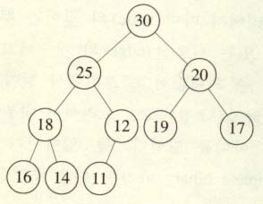
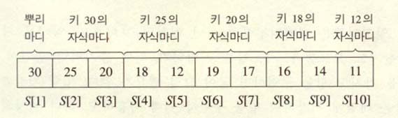
Array representation of the heap
⇒

Slide 9
struct heap {
keytype S[1..n];
int heapsize; };
void siftdown(heap& H, index i) {
index parent, largerchild; keytype siftkey;
bool spotfound;
siftkey = H.S[i];
parent = i; spotfound = false;
while (2*parent <= H.heapsize &&! Spotfound){
if(2*parent < H.heapsize
&& H.S[2*parent] < H.S.[2*parent+1])
largerchild =2*parent+1; //right larger child
else largerchild=2*parent; // left larger child
if(siftkey<H.S[largechild]){ // if child is larger
H.S[parent]=H.S[largerchild]; // move larger child
parent=largerchild; // to the parent
} // end of if
else spotfound=true;
} // end while
H.S[parent]=siftkey; // parent loc. is spot loc.
} // end of shiftdown

Slide 10
keytype root(heap& H) {
keytype keyout;
keyout=H.S[1];
H.S[1]=H.S[heapsize]; //far-right to root
H.heapsize=H.heapsize-1;
Siftdown(H,1);
return keyout;
} // end of root
void removekeys(int n, heap& H, keytype S[]) {
index i;
for (i=n;i>=1;i--)
S[i]=root(H);
} // end removekeys
void makeheap(int n, heap& H){
inde i;
H.heapsize=n;
for (i=⎣n/2⎦;i>=1;i--)siftdown(H,i);
} // end of makeheap

Slide 11
void heapsort(int n, heap & H)
{
makeheap(n,H);
removekeys(n,H, H.S);
}

Slide 12
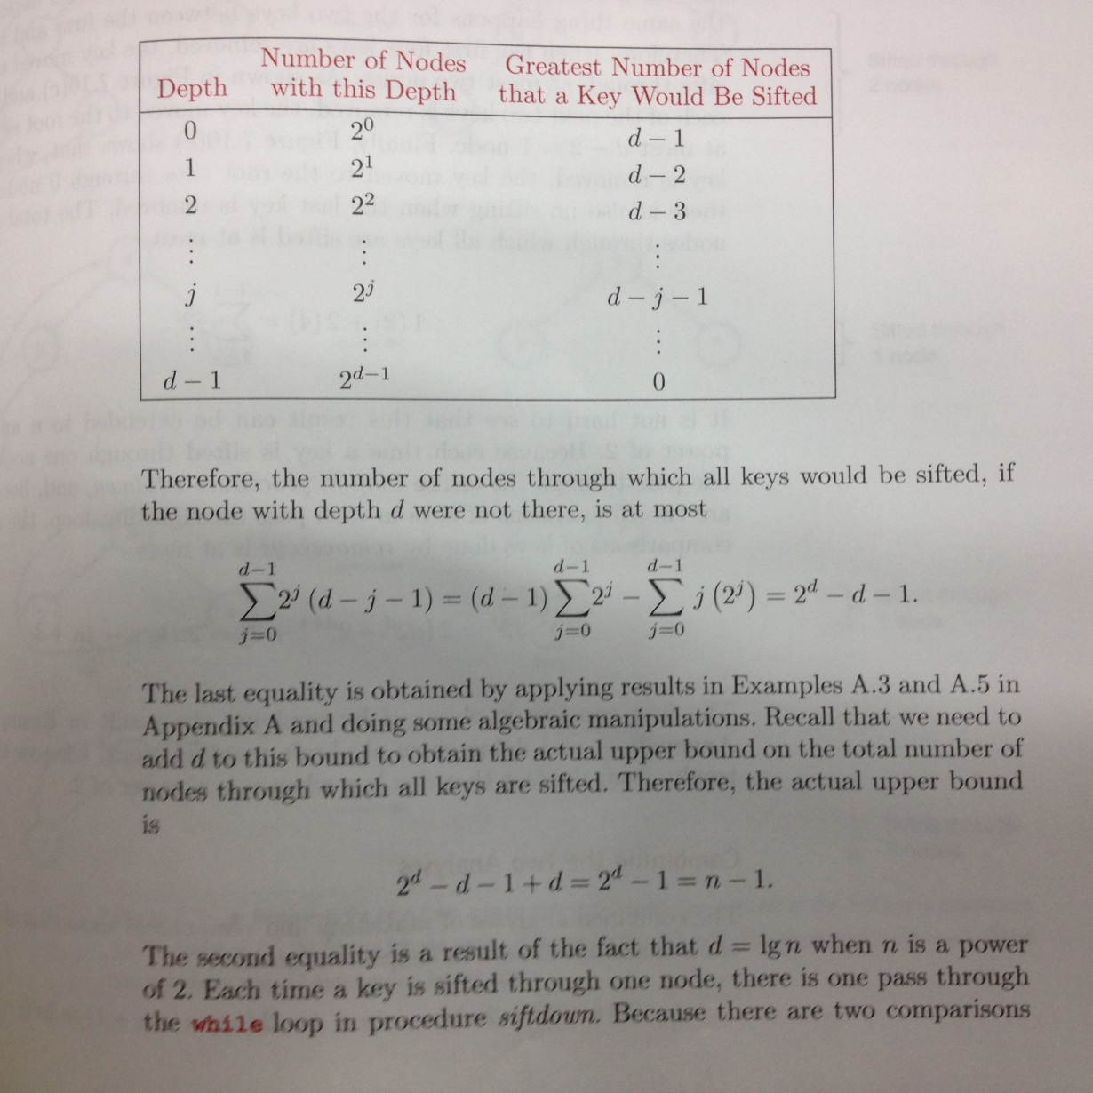
Analysis of makeheap

Slide 13
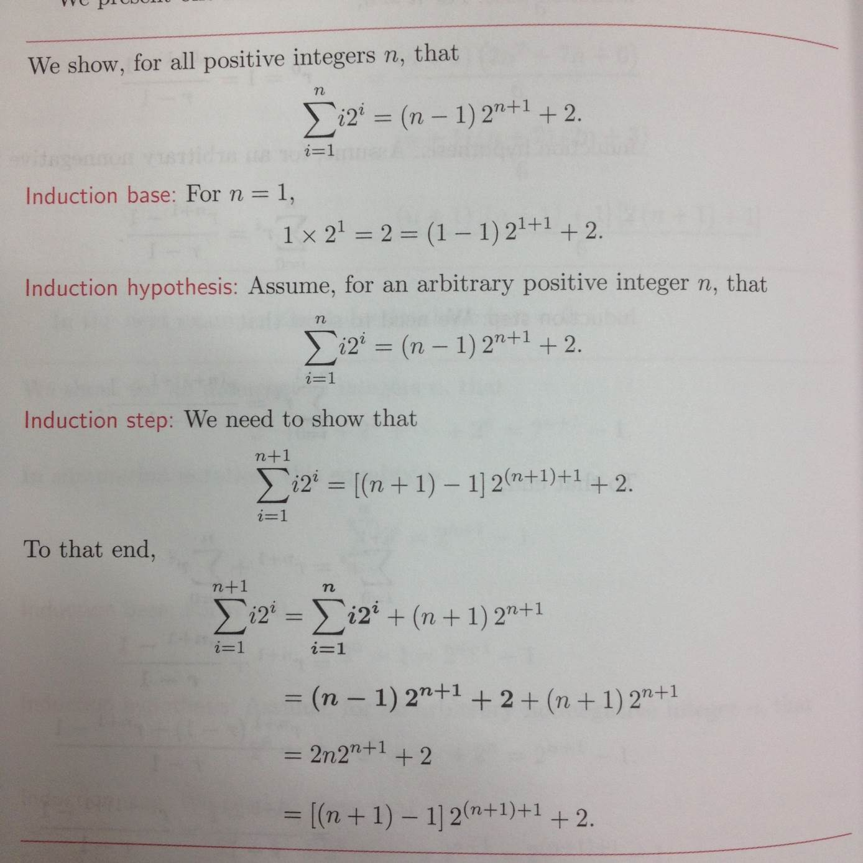

Slide 14

Analysis of makeheap(cont.)
because there are two comparisons of keys in each pass through that loop
  2(n-1) comparisons at the makeheap

Slide 15
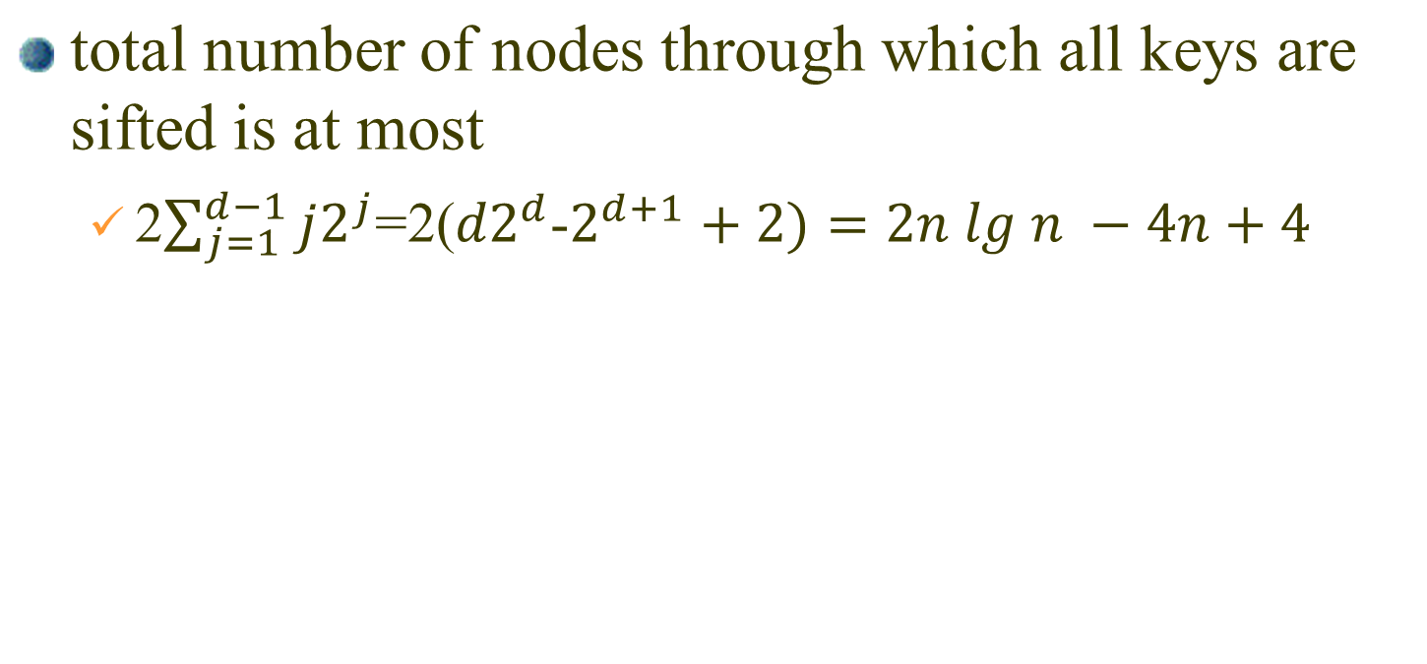
analysis of removekeys

Slide 16
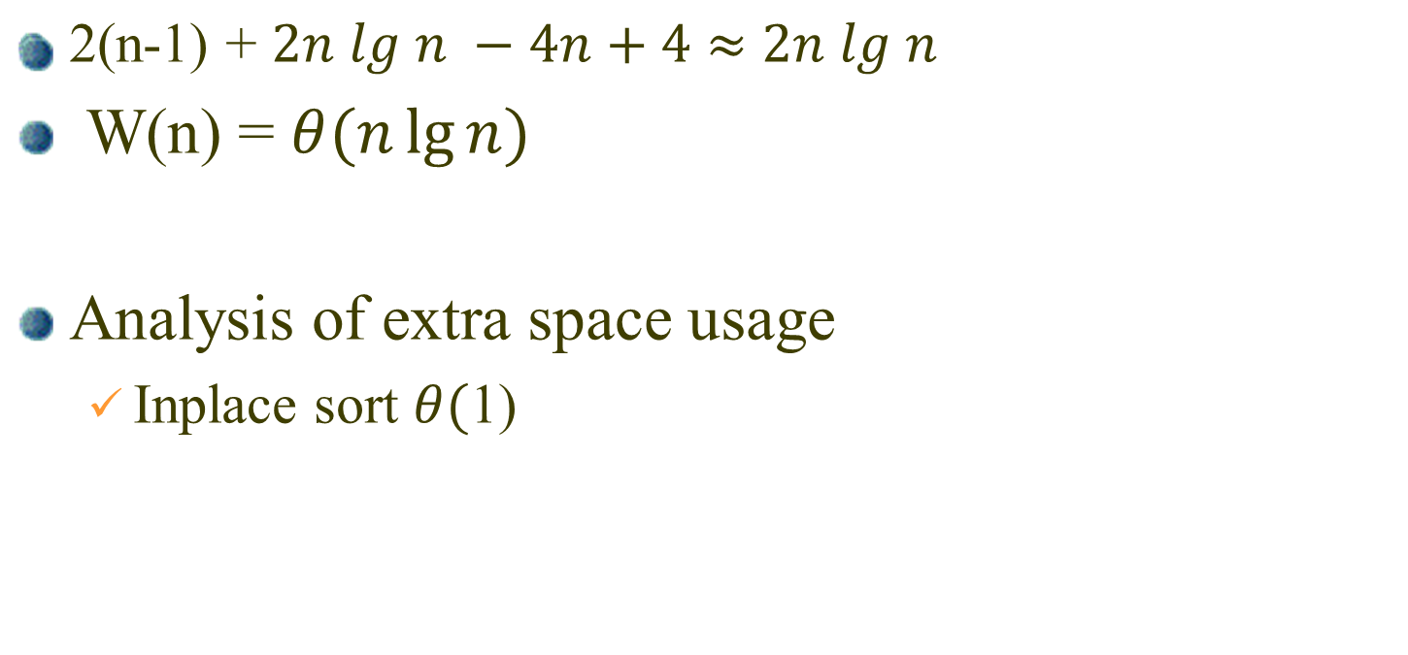
combining the two analysis

